Slide 1

DTSA 5509-100 Final Project
By S. Dioquino

Slide 2

Introduction
Motivation:
Loan default is one of the most common problems faced by financial institutions
Credit application and underwriting usually takes time
Automated tools for credit decisions help expedite processes and optimize results
Generate a simple model to optimize default/non-default classification
Data Source:
Kaggle open dataset but no data dictionary provided so assumptions were made
GitHub: https://github.com/sdioq/dtsa5509_100

Slide 3
Data Flow and Model Process
Exploratory Data Analysis
Summary of features
Final Dataset
70-30 train-test split
Model Development and Performance
Logistic Regression
Imputation
Label / one-hot encoding
Significant null values
Merging Bins
Correlation
Multi-collinearity
Normalizing variable
Simple Decision Tree
Random Forest
XGB
Dropping redundant variables
Feature transformation

Slide 4
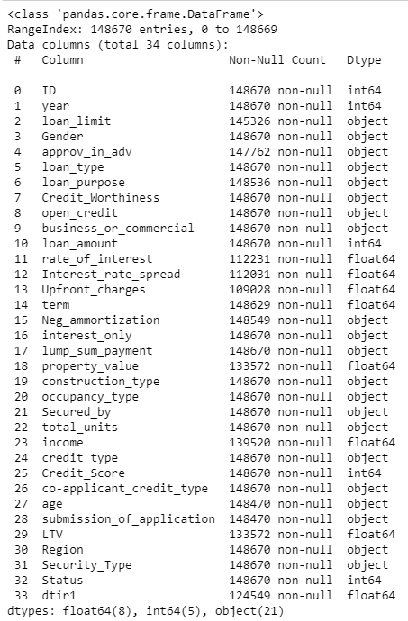
Exploratory Data Analysis
Summary of Features
148,670 observations
34 columns
Target Variable: Status
Features:
Identifiers – ID, year
Categorical – 21 vars
Numeric – 10 vars

Slide 5
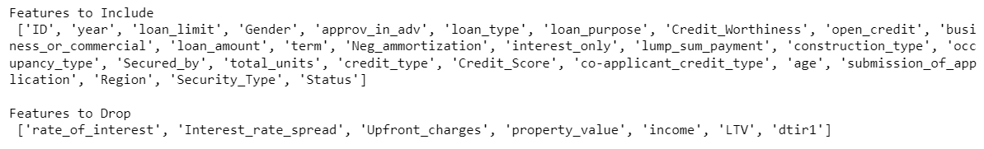
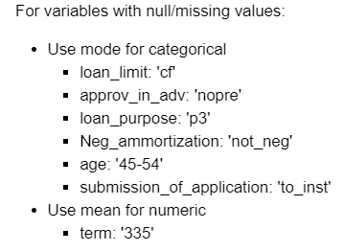
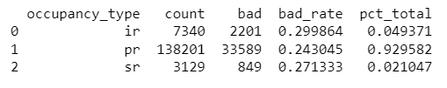
Exploratory Data Analysis
Drop Variables with Significant Null Values
Imputation
Merging Bins

Slide 6
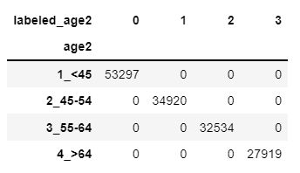
Exploratory Data Analysis
Label-Encoding: creates 1 new column
One-Hot Encoding: creates n new columns
loan_type | loan_type_type1 | loan_type_type2 | loan_type_type3
type1 | 1 | 0 | 0
type2 | 0 | 1 | 0
type3 | 0 | 0 | 1
Be careful of the dummy variable trap!

Slide 7
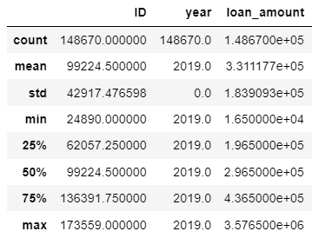
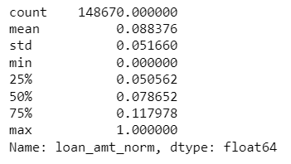
Exploratory Data Analysis
Normalizing numeric values

Slide 8
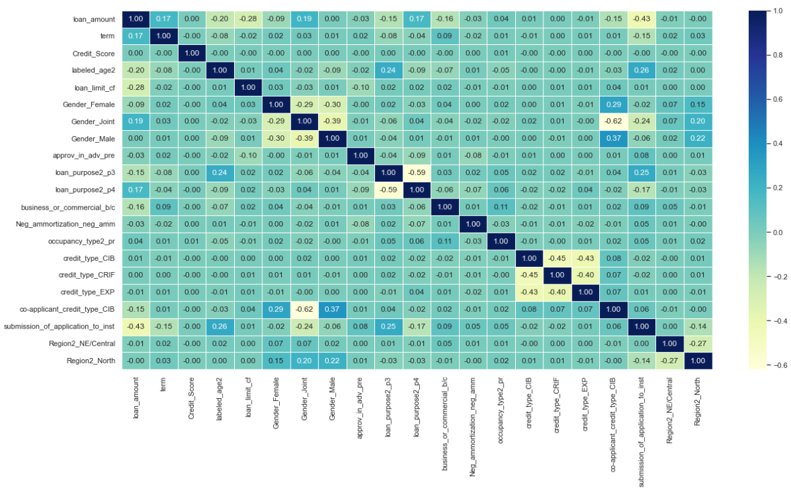
Exploratory Data Analysis
Correlation

Slide 9
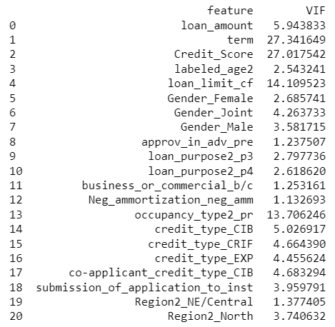
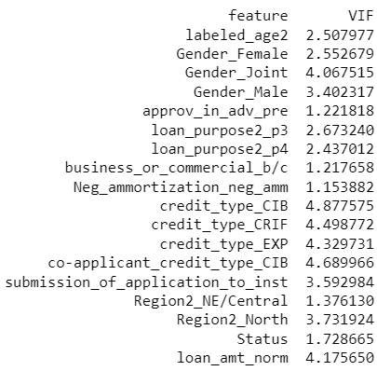
Exploratory Data Analysis
Multicollinearity

Slide 10
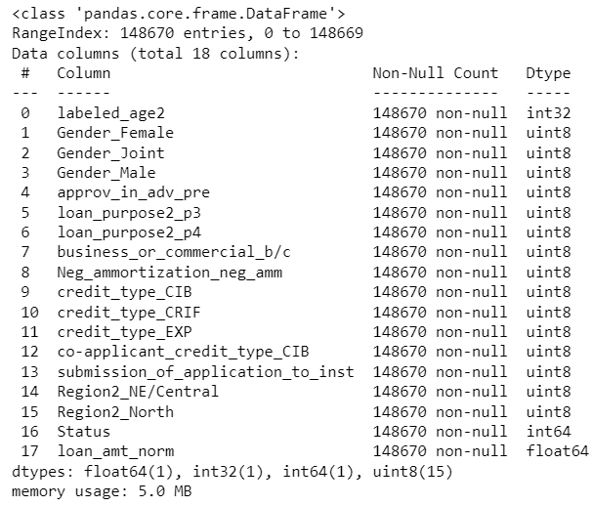
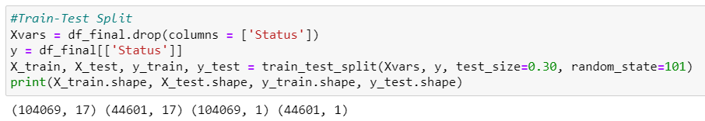
Final Dataset
Summary
148,670 observations
18 columns
Train-Test Split

Slide 11
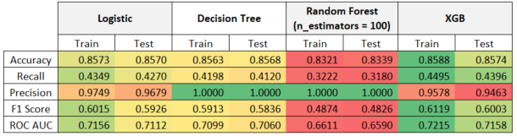
Model Development and Performance
Summary of Results

Slide 12
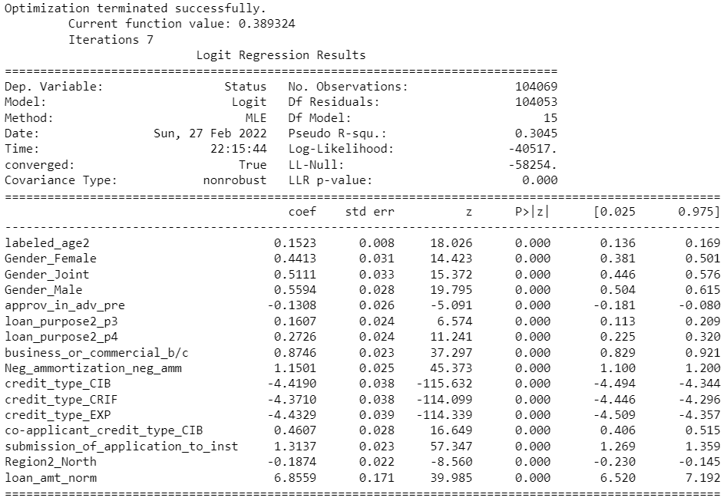
Model Development and Performance
Logistic Regression Model

Slide 13
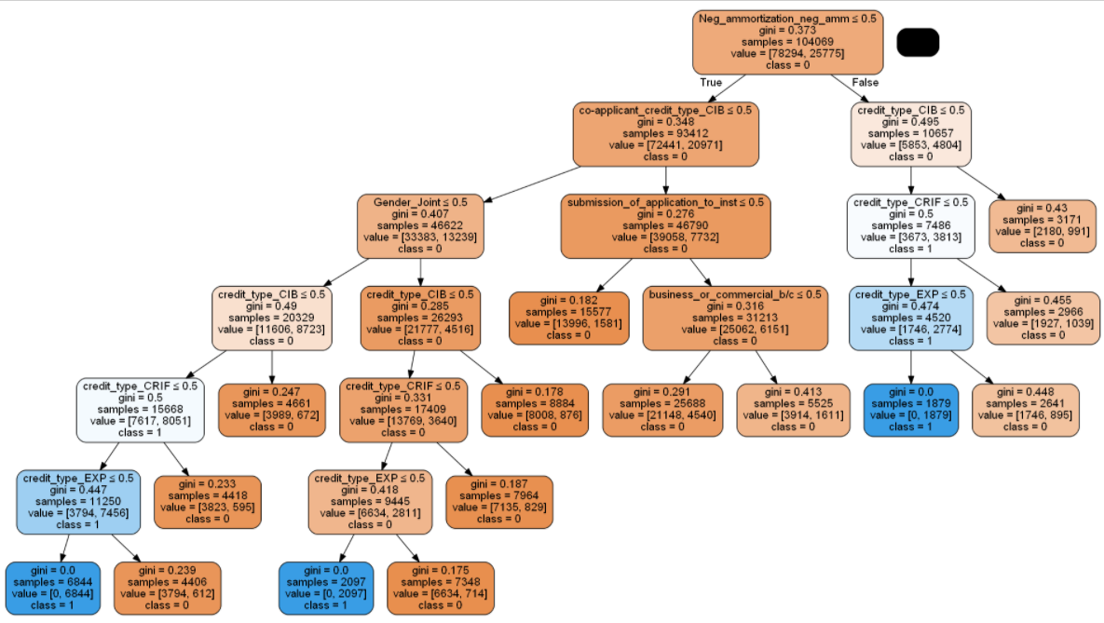
Model Development and Performance
Decision Tree

Slide 14
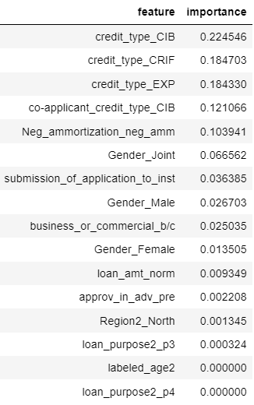
Model Development and Performance
Random Forest

Slide 15
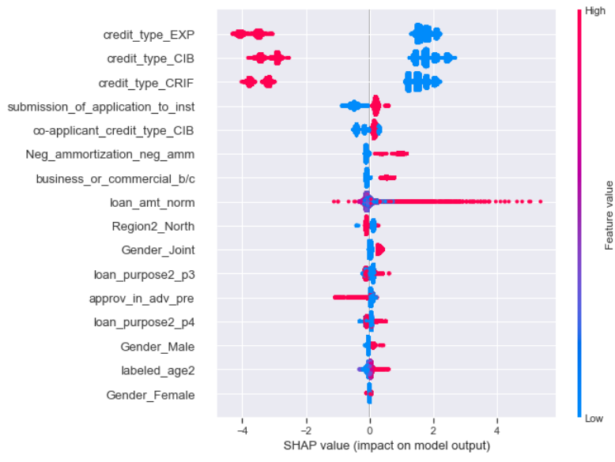
Model Development and Performance
Extreme Gradient Boosting (XGB)

Slide 16
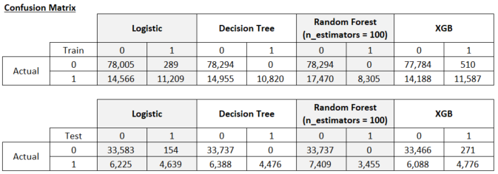
Final Thoughts
Choice of final model will depend on the objective of the financial institution (FI)
Decision tree and random forest models have the highest precision. However, both models have issues in terms of the business sense of some variables.
Logistic and XGB perform well and the performance values are mostly similar. However, XGB, in this case is more conservative as it classified more borrowers as default.

Slide 17
Thank you! ☺

